Slide 1
AlertMedia Data Collection Process

Slide 2
Timeline

Slide 3
Data Collection Distribution
Lynnterm:
Jennifer: Office Staff + Superintendents(Ship/Dock/Grain).
Tim: Dock Foremen.
Andrew: Ship Foremen and Gear Locker.
Mike: Maintenance Foremen.
Squamish:
Emily: Office Staff + Foremen.
Island:
Brent: Cowichan Bay Office Staff & Foremen.
Brent: Tidal Superintendents.
Jordan: Victoria(Ogden Point) Office Staff + Superintendents.
Ryan: BCVPC Office Staff.
Island | BCVPC | Tidal | Victoria = Ogden Point | Cowichan Bay/ NAW Stevedoring | Vancouver Island
Office | Ryan | - | Jordan | Brent | -
Ship Foremen | - | - | - | - | Brent
Superintendents | - | Brent | - | - | -

Slide 4
How Different Info is collected?
Please send email with Google forms to everyone with non-company cell number.
Please ask in person or by calling for those missing.
Collect/ No Collect | Email | Office Number | Cell Number
Foremen | No(only if there is company email in Homa’s list already add it– if missing, please do not ask) | No(only if there is company email in Homa’s list already add it– if missing, please do not ask) | Yes(please send Nelia’s google form to everyone with non-company cell number. Company/personal cell number will be indicated in Homa’s list.
Other Employees | Yes(if missing from Homa’s list, please ask) | Yes(if missing from Homa’s list, please ask) | Yes(please send Nelia’s google form to everyone with non-company cell number. Company/personal cell number will be indicated in Homa’s list.

Slide 5
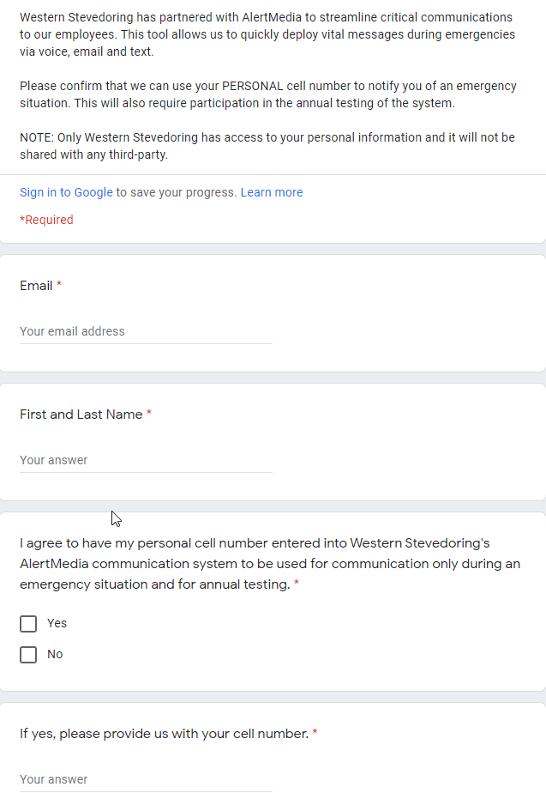
Google Form
Link: AlertMedia - Emergency Communication Tool (google.com)

Slide 6
Office Phone Numbers: Direct vs. Wait Time
Lynnterm: Direct.
Squamish: Wait Time.
Island:
BCVPC: ?
Tidal: ?
Victoria(Ogden Point): ?
Cowichan Bay: ?

